Slide 1

Research on Remote Sensing Applications in Malta
Massimo Darmanin
Institute of Information & Communication Technology
MCAST, Paola, Malta

Slide 2
Problem Definition
Maltese Urban population grew from around 91.7% to just below 95% in 2018 and is increasing each year*.
Population growth and economic development led to an increase in demand for housing and other amenities.
These and other causes contributed to the phenomena of urban sprawl, particularly in rural areas.
*https://data.worldbank.org/topic/urban-development?end=2018&locations=MT&start=1998
Notes:
Growing URBAN population
Population growth causing effects that are starting to bite back at us
Malta vs Urban density and lack of planning

Slide 3
Research Questions
Is Remote Sensing a viable option to track and observe the Urban Heat Island(UHI) effect in Malta?
Does the UHI effect exist in Malta?
Can UHI be tracked and analysed accurately over a period of years using Remote Sensing technologies?
What kind of observations can this data provide?

Slide 4
Hypothesis
The UHI effect does indeed affect Malta.
Very high Land Surface Temperature(LST) values and low NDVI values between June - August.
Lower LST values and Higher Normalised Difference Value Index(NDVI) values during March - May.
Urban Area part of coastline might influence results and observations.
Notes:
UHI exists
Peak LST in summer
Lowest NDVI in summer
Vice versa for winter
Maltese geography might affect results since it is surrounded by the sea

Slide 5
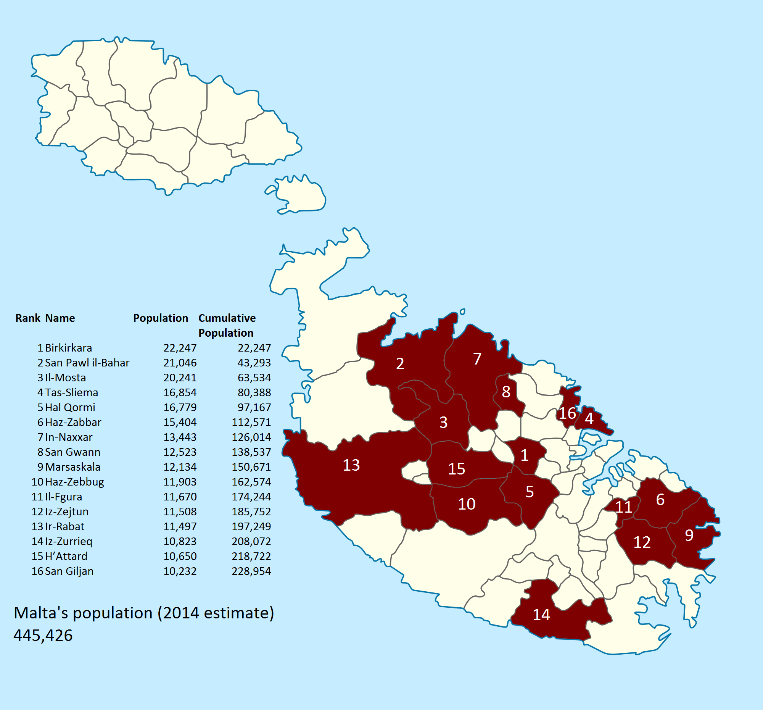
Literature Review
The Urban Area
Built-up areas with high population densities and infrastructures of the built areas.
The threshold population size for an urban settlement varies from 200 to 50,000 people*.
* https://ourworldindata.org/urbanization
https://www.reddit.com/r/MapPorn/comments/40xm0c/half_of_maltas_population_lives_in_the_red_area/
Notes:
Talk about why you are explaining Urban areas:
Definition is flexible according to country
Relevance for lit review

Slide 6
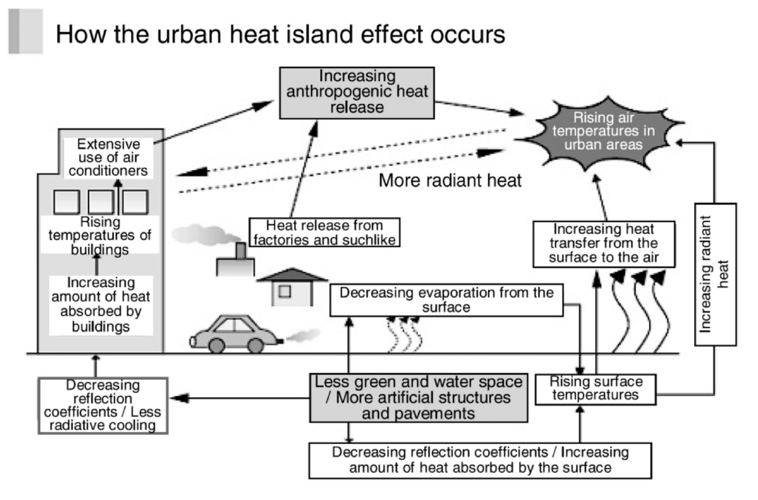
Literature Review
Urban Heat Island (UHI)
UHI is the heat accumulated by the urban climate created by human activities (Arnfield 2003, Nakayama & Fujita 2010)
UHI observed in cities with less than 10,000 citizens (Karl et al. 1988).
Image sourced from Yamamoto (2006)
Notes:
1. An urban heat island, or UHI, is a metropolitan area that's a lot warmer than the rural areas surrounding it. Heat is created by energy from all the people, cars, buses, and trains

Slide 7
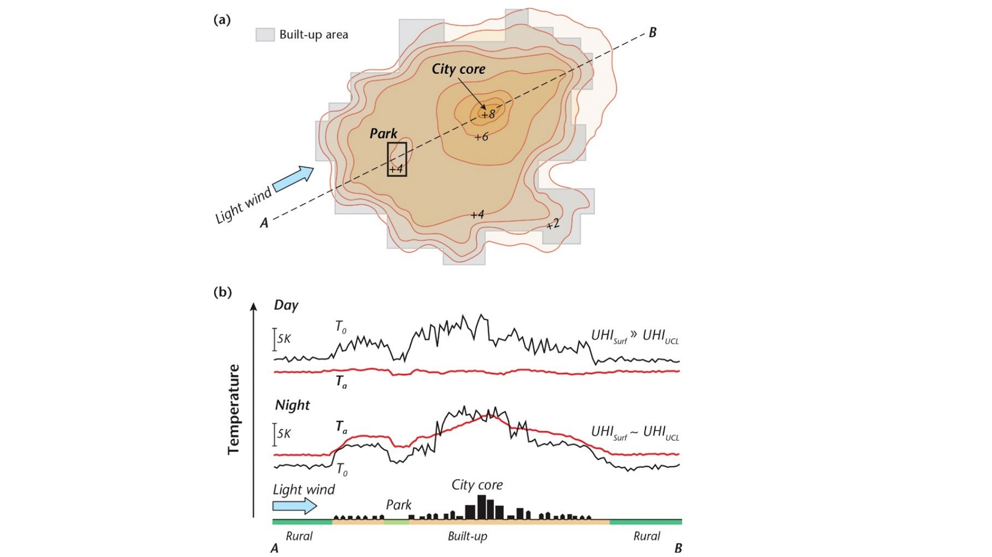
Literature Review
Studies observed a significant difference between air temperature at urban areas vs rural regions (Landsberg 1981).
Results from data during the night showed that rural areas had a mean LST lower than urban areas (Roth et al. 1989).
Image sourced from: https://www.canada.ca/en/services/health/publications/healthy-living/reducing-urban-heat-islands-protect-health-canada.html
Notes:
It is cited that the major contributor to the UHI effect is the decrease of heat stored in the soil and vegetation in urban areas (Carlson et al. 1981).
2. studies observed that there was a significant difference between air temperature recorded at urban areas with those located in rural regions
3. UHI stems from the changing nature of our urban cities, the result of a decrease in vegetation, higher prevalence of dark surface and an increase in anthropogenic heat production

Slide 8
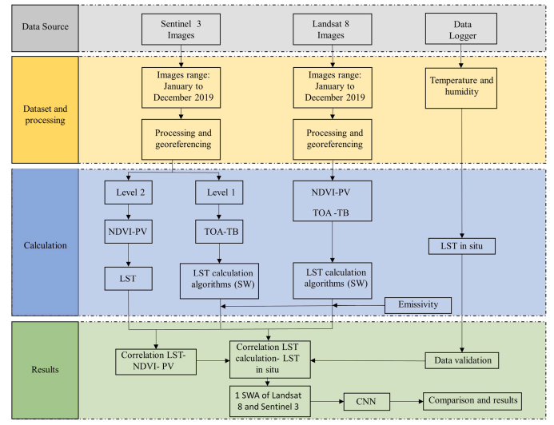
Literature Review
A study conducted by Hidalgo Garcia (2021), used LandSat 8 and Sentinel 3 images to estimate the LST over the city of Granada in Spain.
Data was validated with the temperature values gathered from in situ measurements.
Notes:
Remote Sensing accuracy and precision was investigated in a study by Hidalgo Garcia, by gathering temperature readings from in situ measurements and comparing them with the processes values from LandSat 8 and Sentinel 3 products

Slide 9
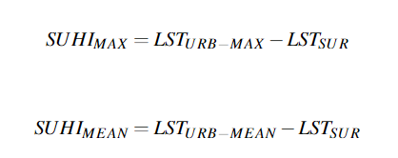
Literature Review
Sobrino & Irakulis (2020) proposed a new methodology on how to calculate and compare Surface Urban Heat Island(SUHI) values.
The method suggests calculating SUHI for the surrounding areas using only LST acquired during night-time.
This method was applied to 71 selected urban agglomerations around the world.
Notes:
Since a lot of literature focuses and adapts its methodology according to the individual study areas, a new standard methodology was proposed and tested on over 71 different cities and urban areas.
This includes the calculation of SUHI:
SUHIMAX : which can be described as thermal differences between the maximum
SUHIMEAN : mean LST of the urban area and the LST surrounding area respectively

Slide 10
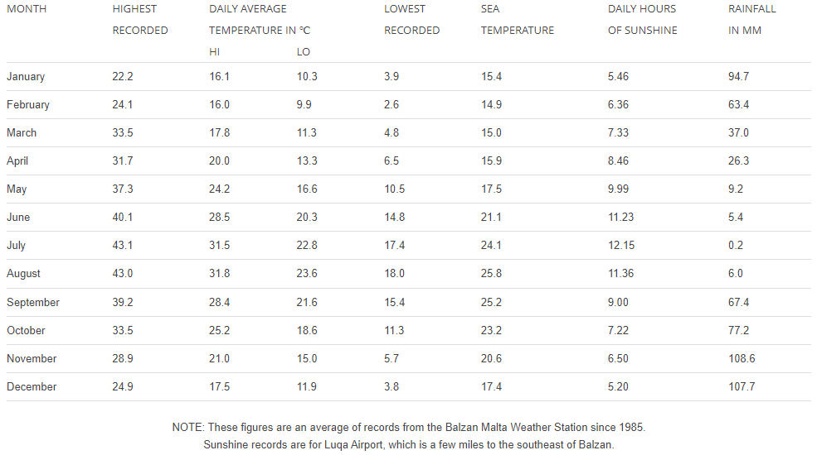
Literature Review
Maltese Climate*
The approximate number of sunshine hours is 3000 hours per annum
Averaging from 5.2 hours in December to 12 hours in July.
Malta has double that of cities in the Northern part of Europe
*https://web.archive.org/web/20150806124550/http://www.maltaweather.com/information/maltas-climate/
Notes:
Quick summary
We get 3k hrs of sun per yr which makes it twice the average of eu cities. Hence Malta is much more likely to experience severe UHI than eu countries

Slide 11
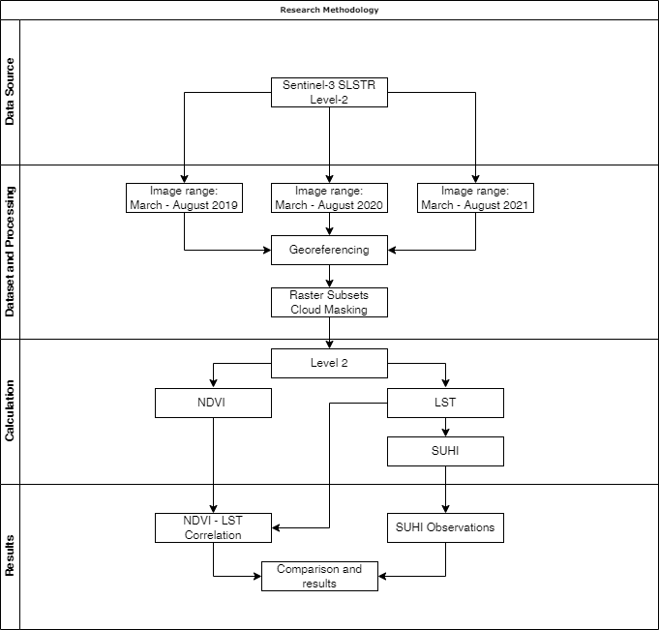
Methodology Research Pipeline
Dataset collection.
Dataset Processing.
Extraction and Manipulation of data.
Data analysis and Results
Notes:
Mention parts only

Slide 12
Methodology Dataset Collection
Level-2 LST products were gathered from the Sentinel-3 mission.
Products range from the months of March till August, from 2019 up until 2021.
Night-time remote-sensed products have been used.
A total of 74 SLSTR Level-2 LST products were downloaded for this research.
Notes:
By using the European Space Agency’s public database, remote sensing products ranging from March till August from 2019 up till 2021 were downloaded. These products were specifically chosen due to their orbital timing during the early hrs in morning which count as night time products. This was done to better visualise UHI effects.

Slide 13
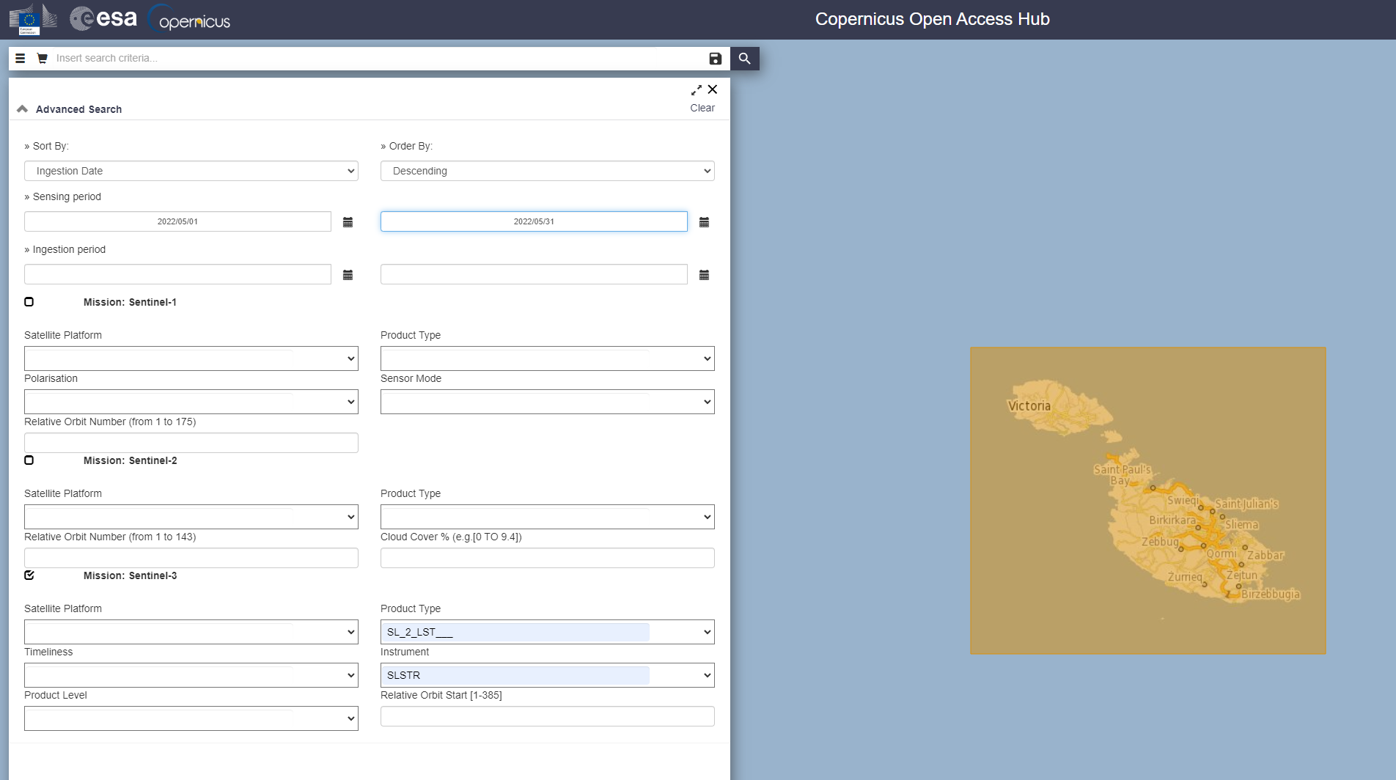
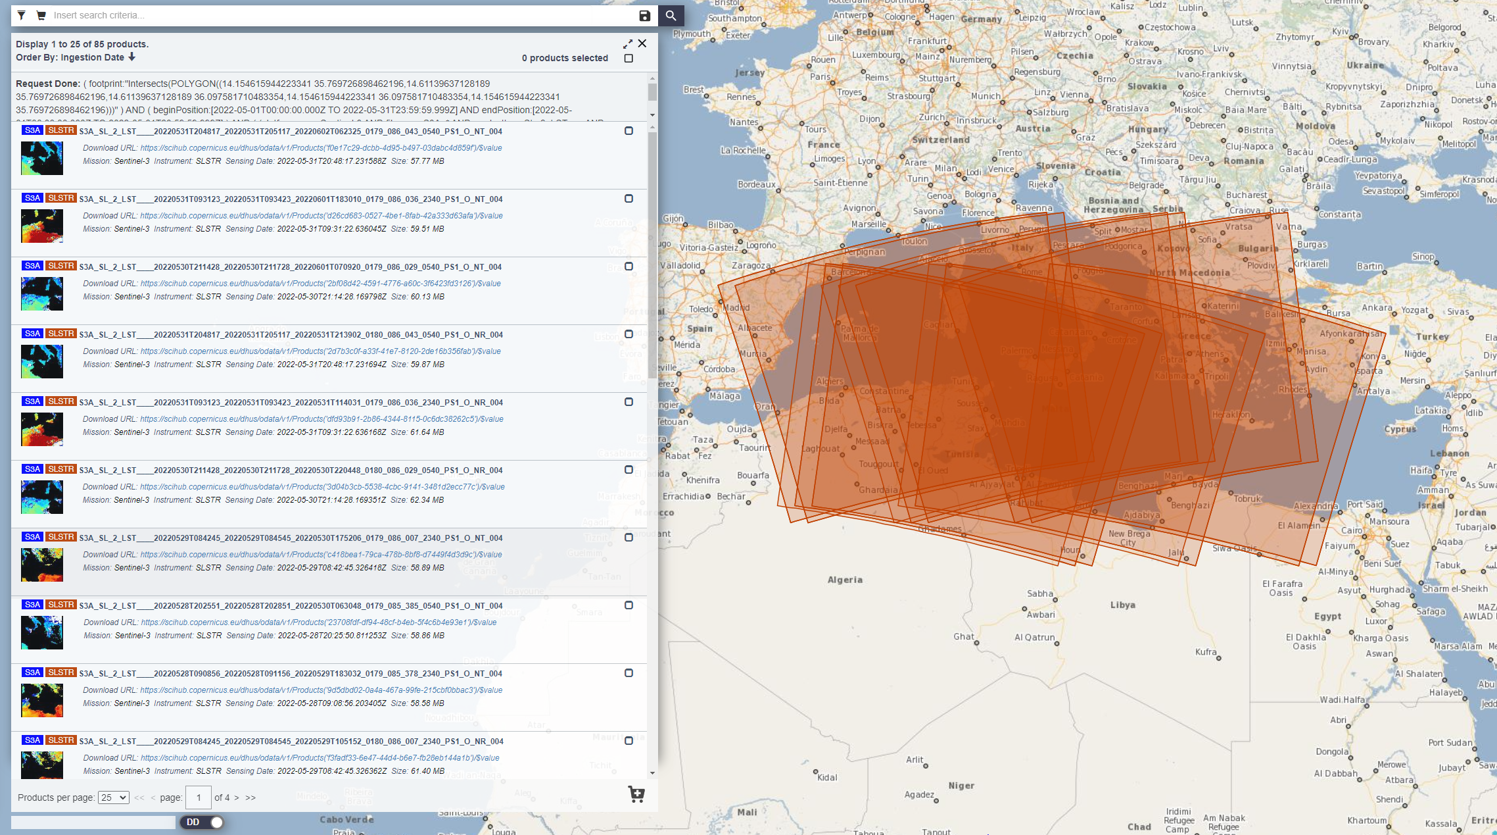
Methodology Dataset Collection
Product list (below)
Setting Range and Area (above)
Notes:
This is how the products were downloaded

Slide 14
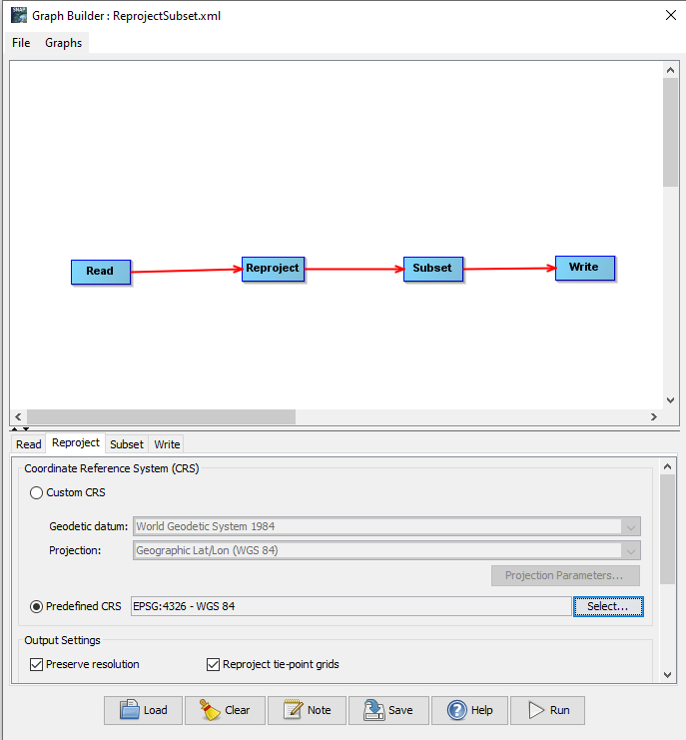
Methodology Dataset Processing
A graph consisting of a Read, Reproject, Subset and Write functions was created.
List and open each product.
Each product had to be re-projected to the Coordinate Reference System (CRS) EPSG:4326.
A subset of each product was created.
Write Reprojected Subset Image as a GeoTiff file (.tif).
Cloud masking each product.

Slide 15
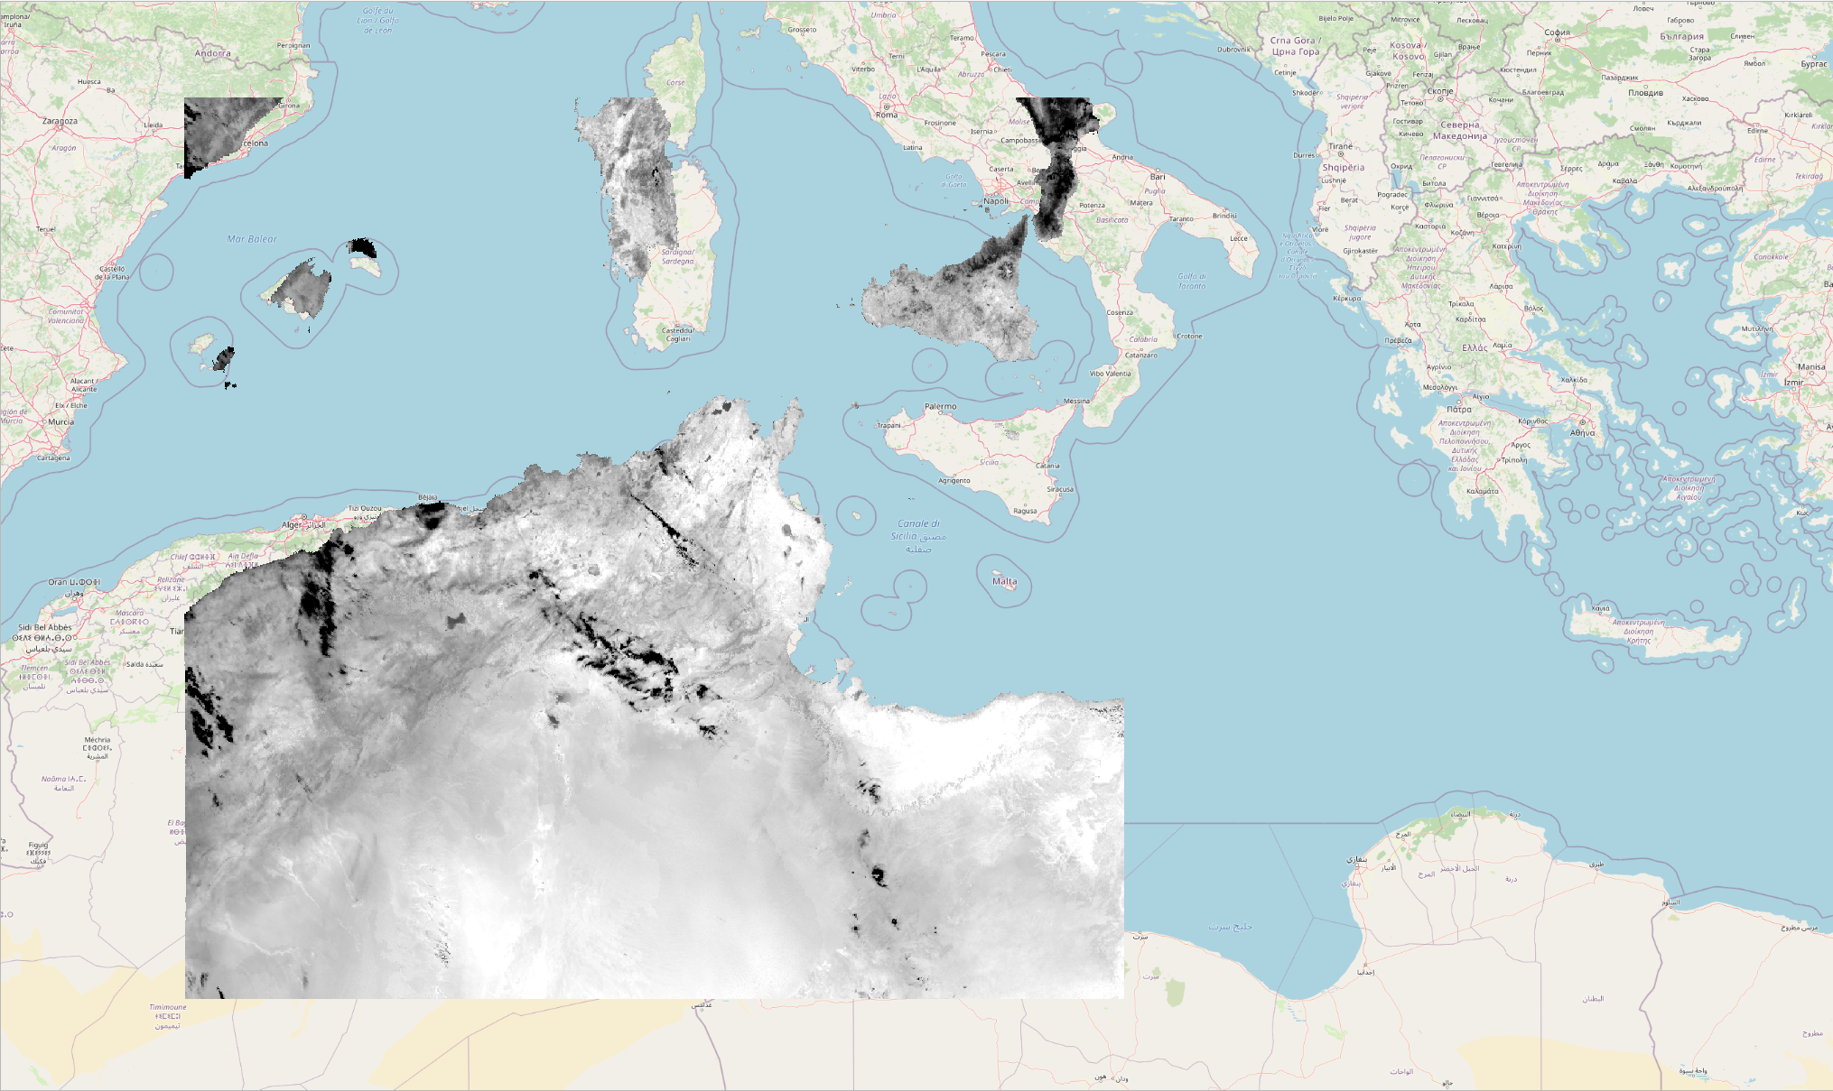
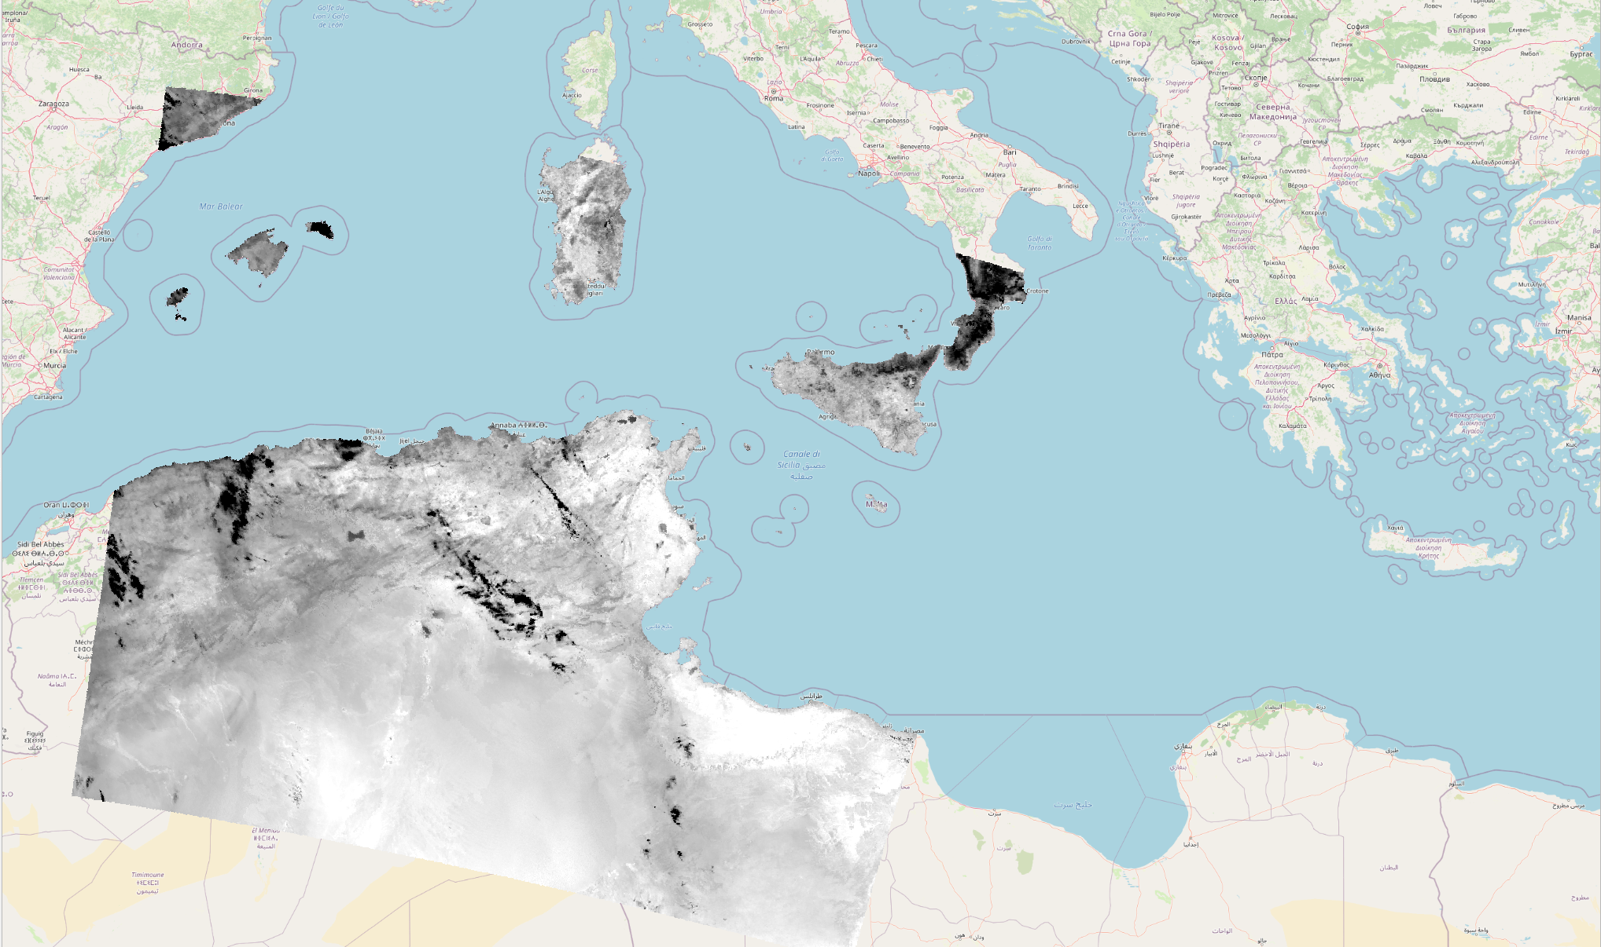
Methodology Dataset Processing
Reprojection
Before
After

Slide 16
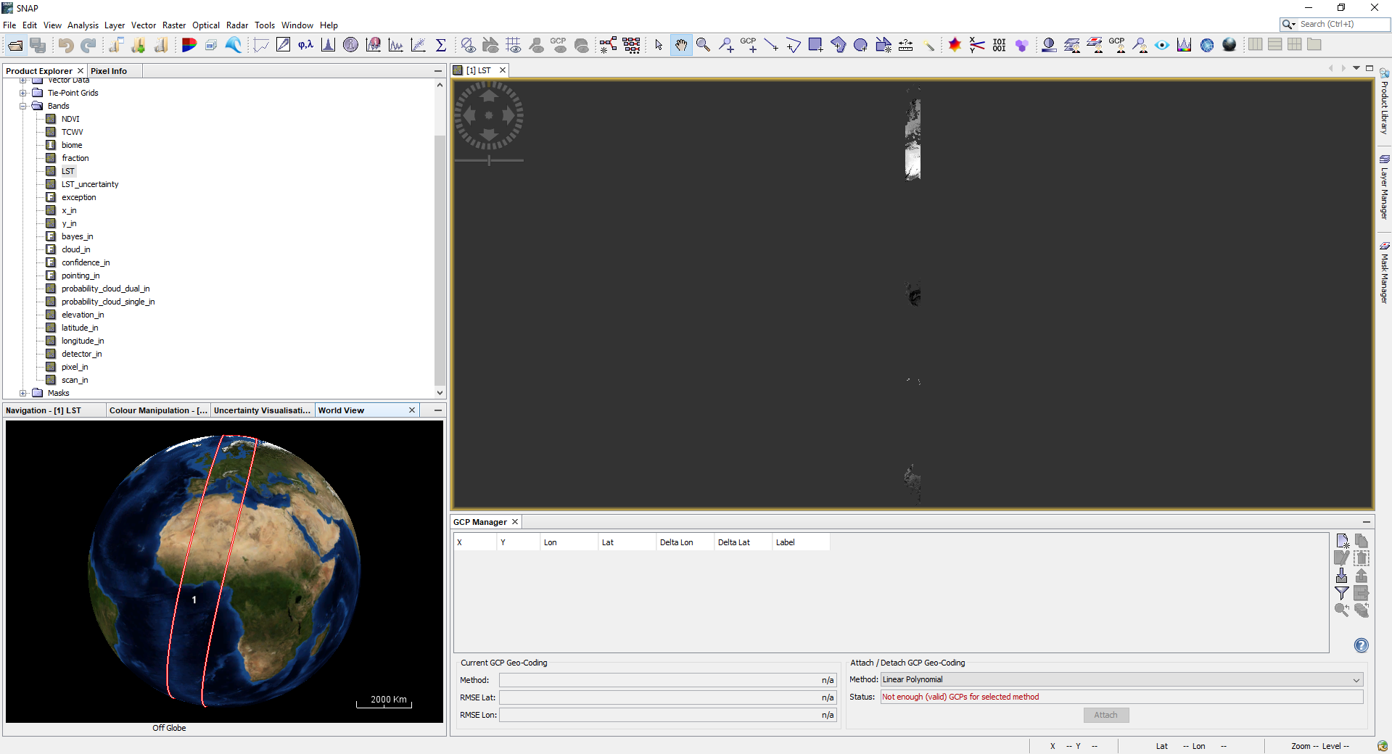
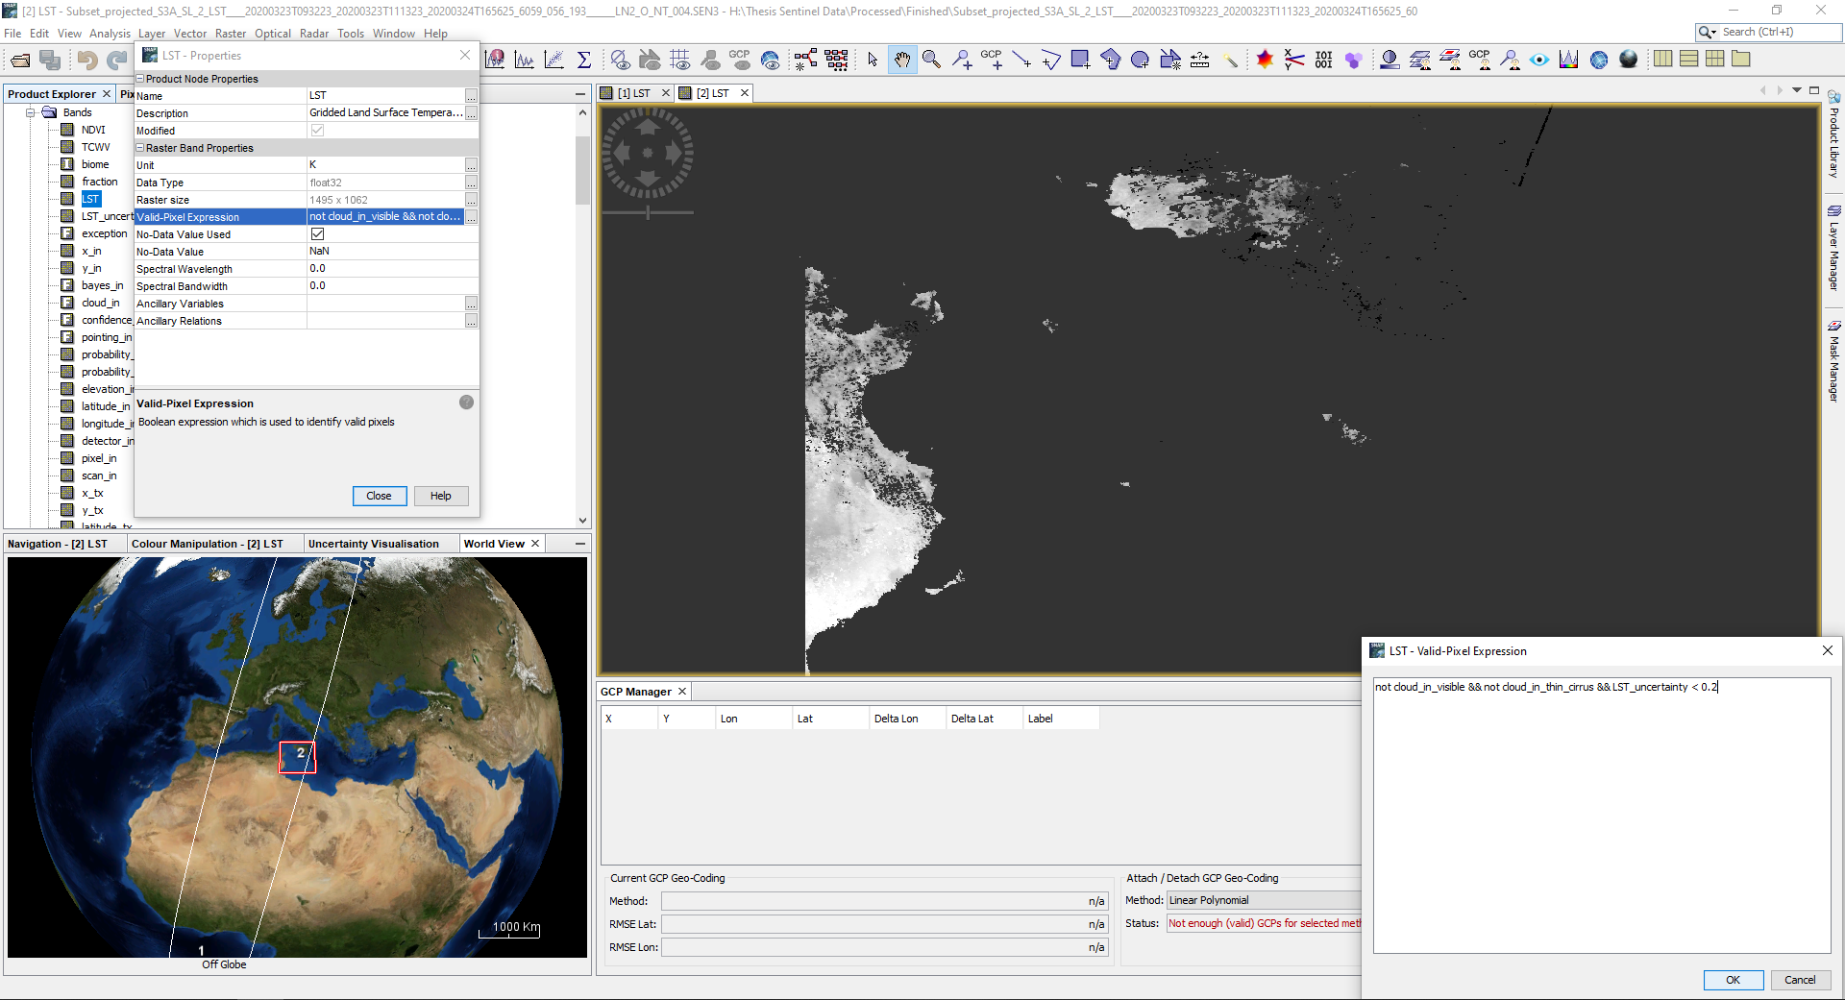
Methodology Dataset Processing
Subset and Cloud Masking
Before
After

Slide 17
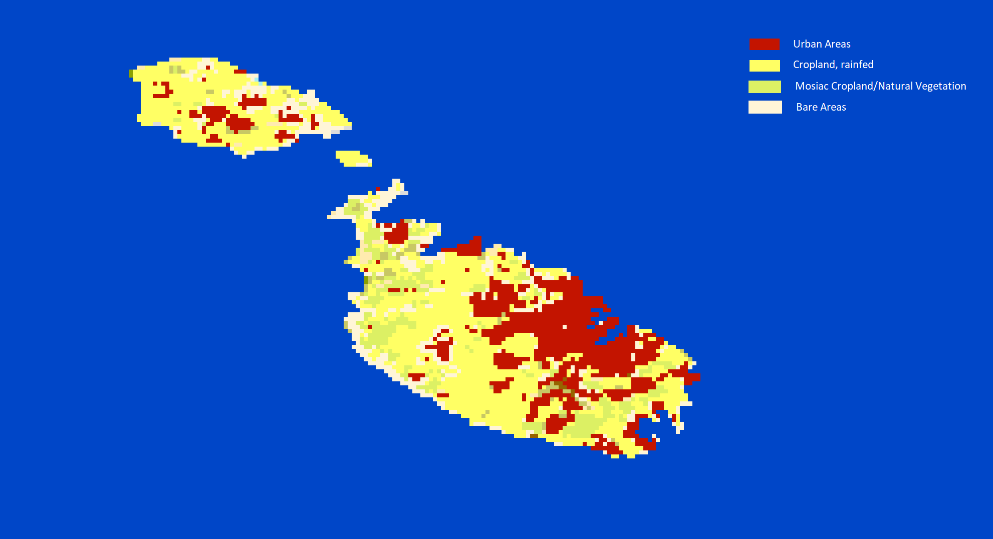
Methodology Extraction and Manipulation of data
ESPON and the EU Commission studies stated that, “the whole territory of Malta constitutes a single urban region”.
Eurostat describes Malta as being composed of 2 urban areas, “Valletta” and “Gozo”.
https://maps.elie.ucl.ac.be/CCI/viewer
https://www.espon.eu/sites/default/files/attachments/fr-1.1.1_revised-full_0.pdf https://ec.europa.eu/regional_policy/sources/docoffic/official/reports/coheter/coheter_en.pdf

Slide 18
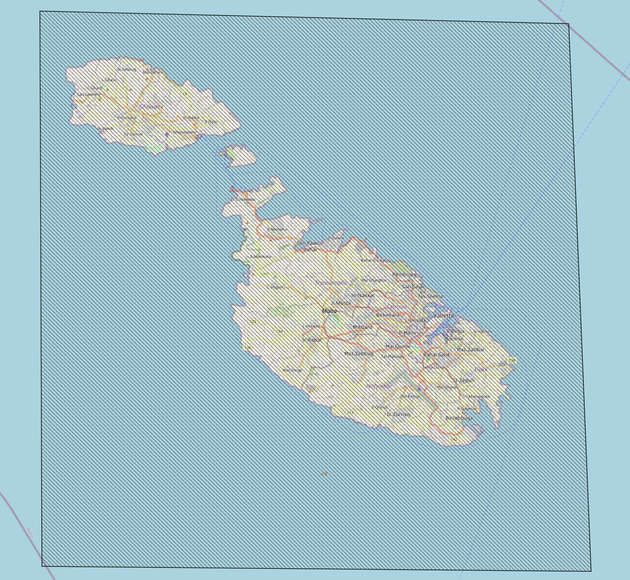
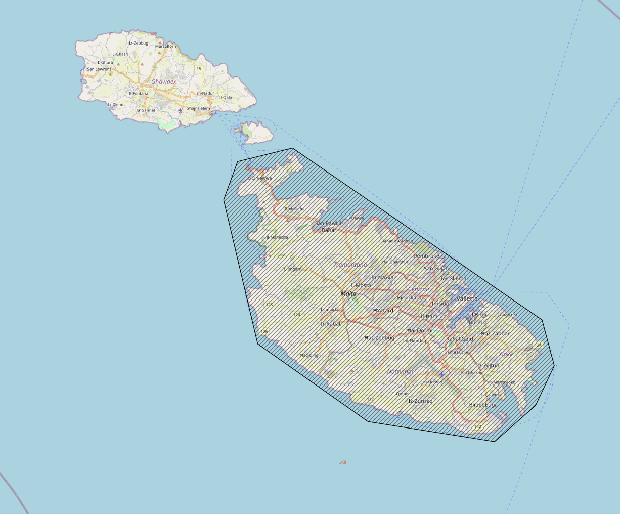
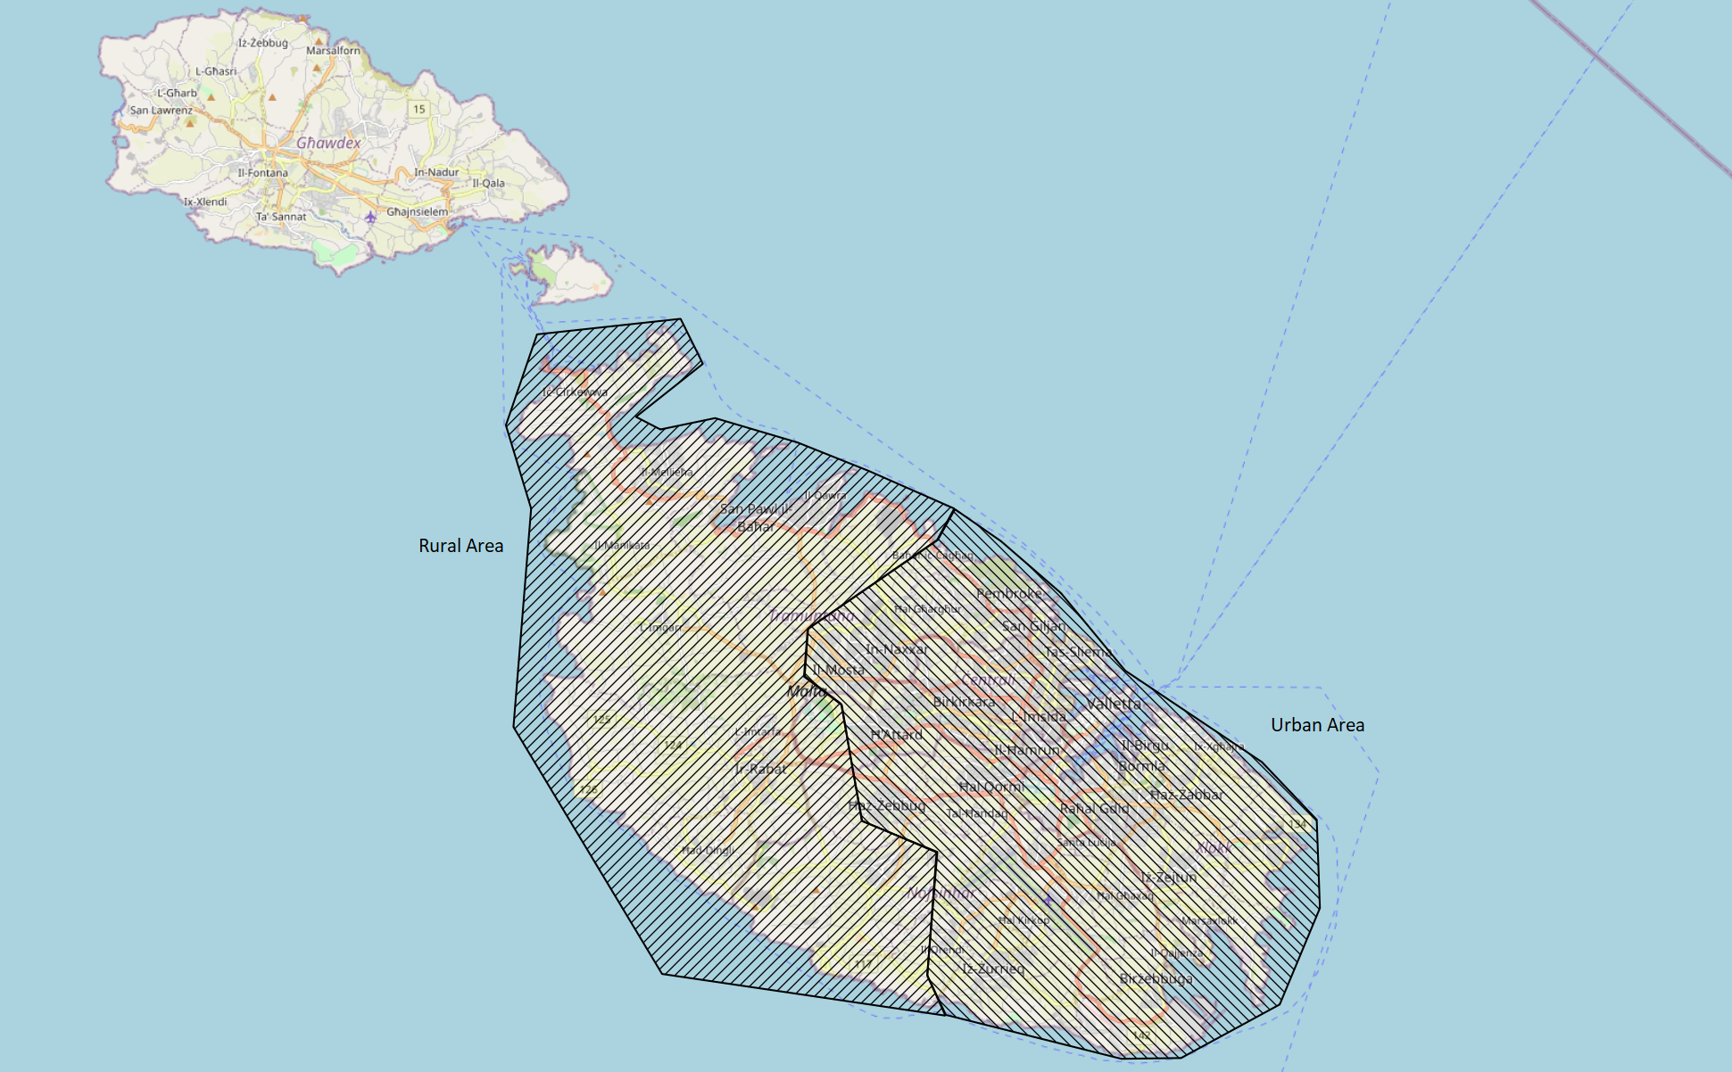
Methodology Extraction and Manipulation of data
A python script was created to traverse all the newly created image (.tif) files.
Each image was split into 4 more subsets:
Maltese Islands
Island of Malta
Malta’s Urban area
Malta’s Rural area

Slide 19
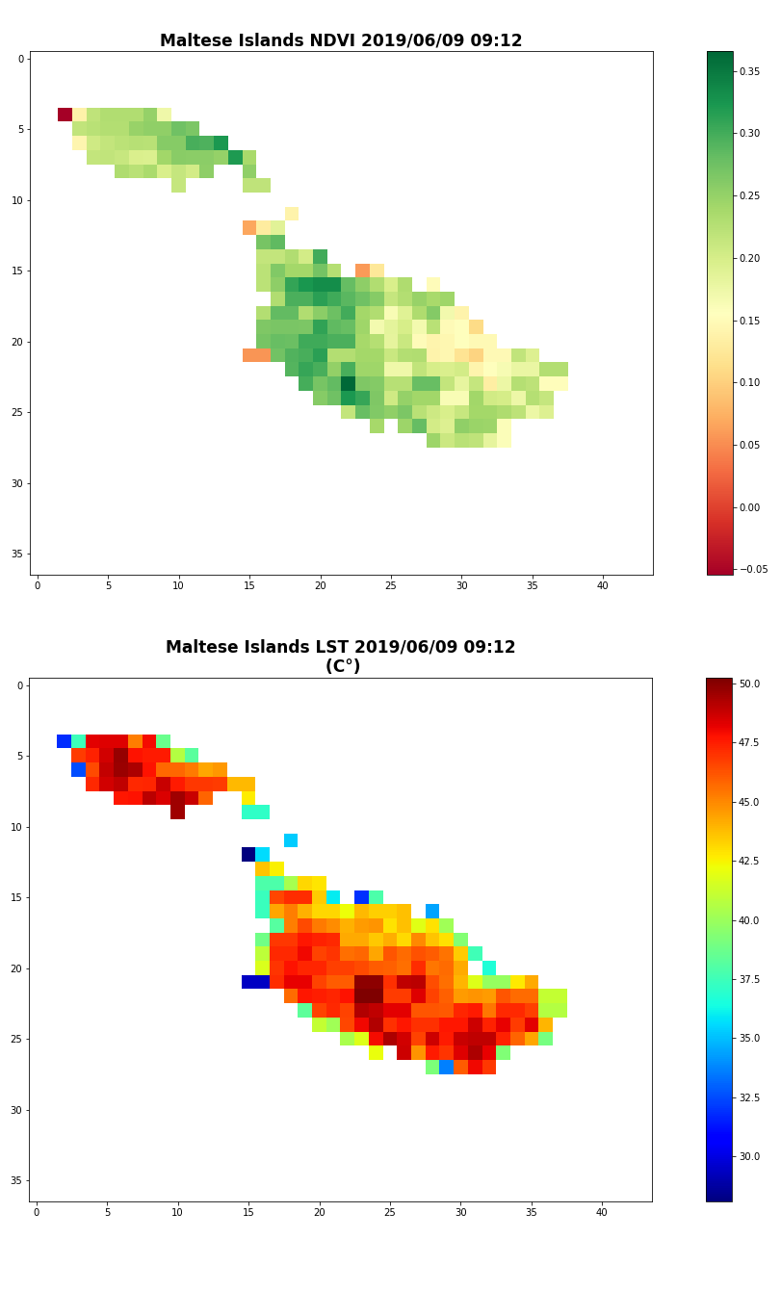
Methodology Extraction and Manipulation of data
Each subset is made up of two Raster bands LST and NDVI.
Each Band was normalised and cleaned from null values.
Mean, Minimum and Maximum pixel values were recorded for each band for each subset.

Slide 20
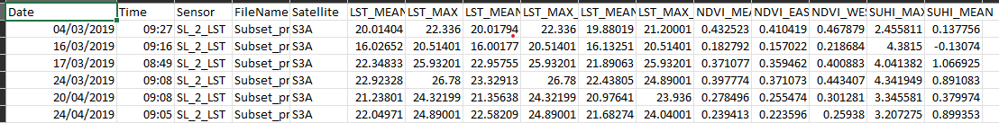
Methodology Extraction and Manipulation of data
Following Sobrino & Irakulis (2020) methodology, SUHI_MAX and SUHI_MEAN were calculated.
Data recorded from the images were saved to a Comma Separated Values(CSV) file.

Slide 21
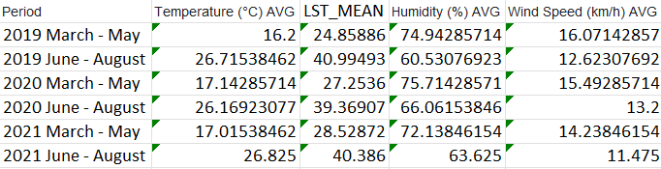
Results
Mean LST values compared to weather data.
Confirming Hidalgo Garcia (2021) conclusion about the accuracy for Sentinel-3.

Slide 22
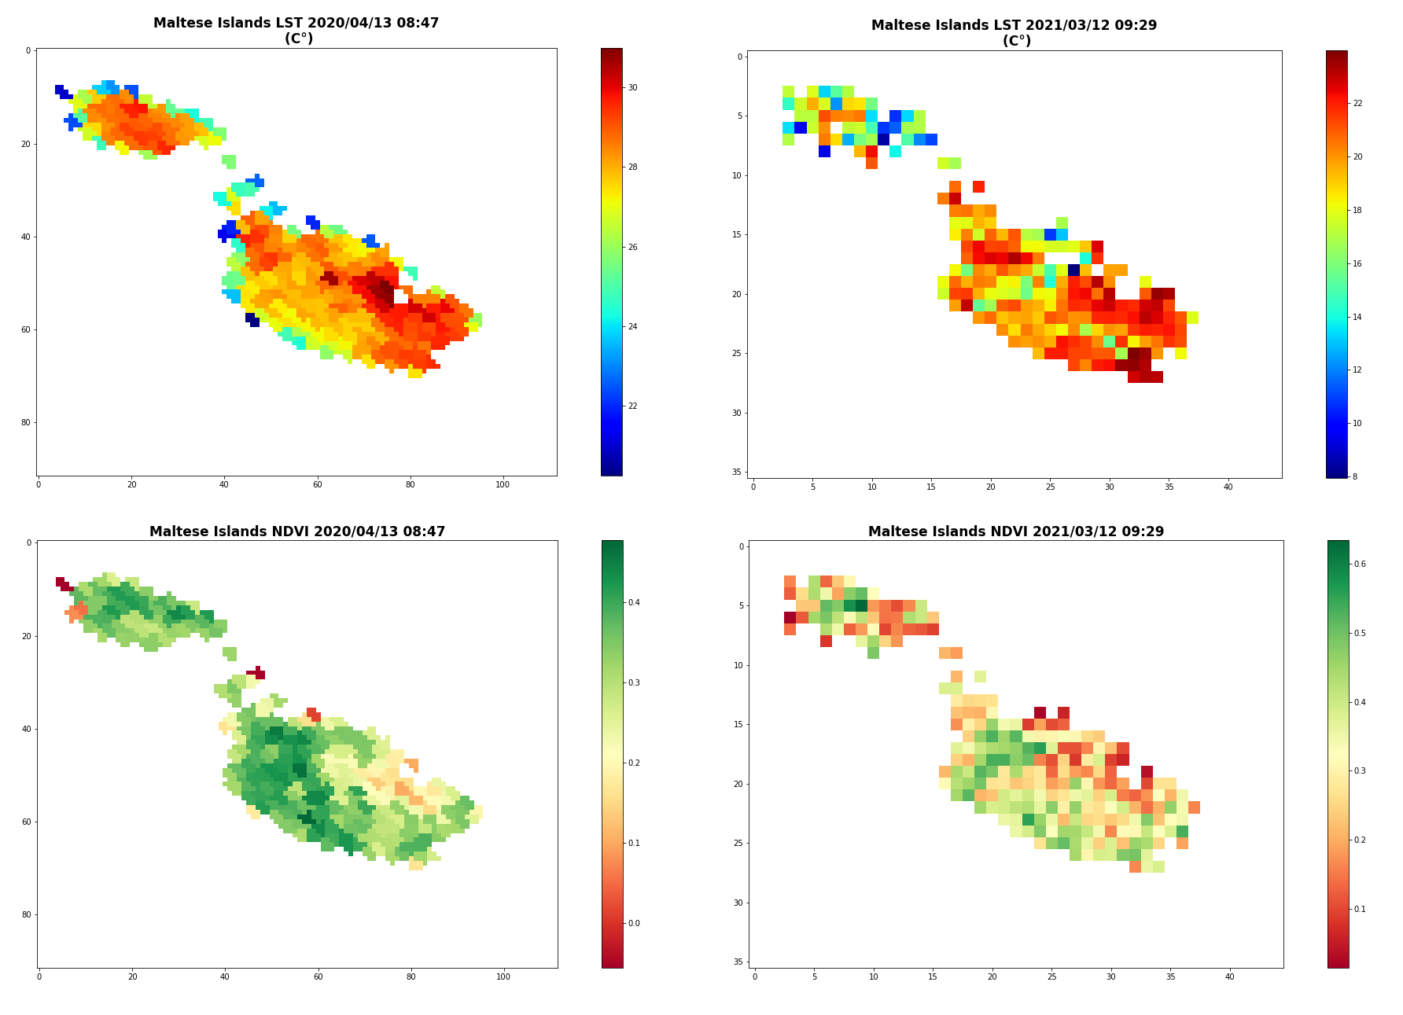
Results
Initial Observations
LST values make UHI observable.
Peak LST values happen in Summer.
Green spaces and Vegetative areas emit the least LST values
Developed or barren areas emit the highest LST values.

Slide 23
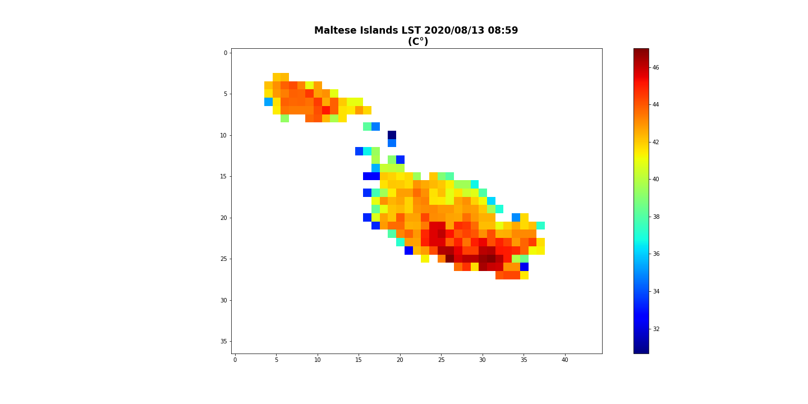
Results
Geographical position and the effect of the sea breeze on temperatures is mitigated by the presence of vast bodies of water.
This phenomena overlaps with UHI in coastal cities, causing local climate change.
Abnormal temperatures in areas which literature about inland cities says should not exist.

Slide 24
Results
Analysis for “Covid” Period
Upward trend in LST values and a downward trend for NDVI.
Slight decrease in uptrend was noticed throughout the year 2020.
Mean LST +15%
Increase in temperature equal for both the Rural and Urban areas.
Mean NDVI -12.4%
Decrease in NDVI values in the Rural areas higher than the Urban Area
-13% in the Rural VS -10% in the Urban area,
Notes:
Slight decrease in uptrend was noticed throughout the year 2020 - This means that daily human activities, although not enough to reverse the uptrend immediately, are also part of the bigger picture when studying UHI
Increase in temperature equal for both the Rural and Urban areas -This means that the Rural area was not able to dissipate heat any quicker than the Urban area.

Slide 25
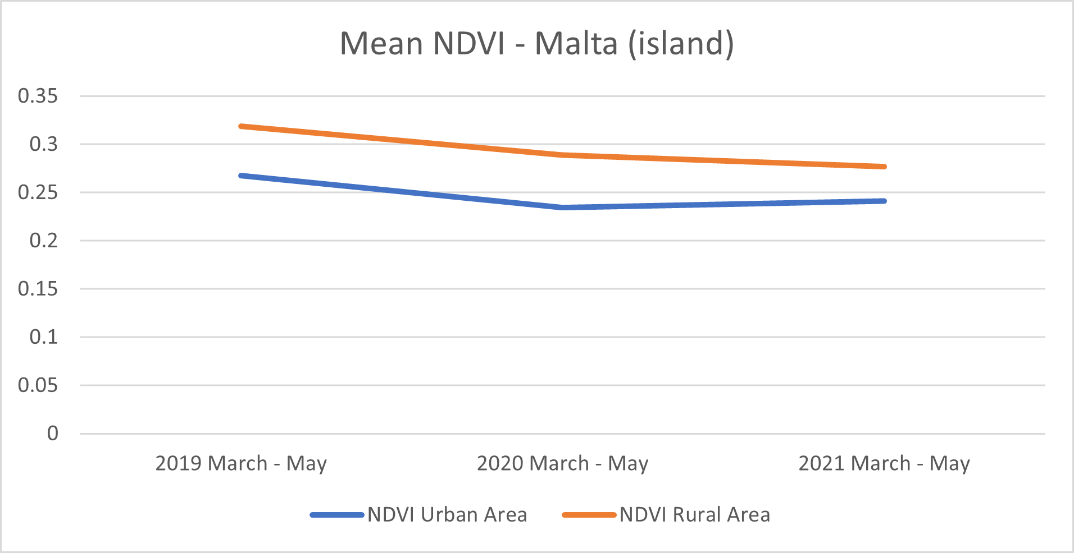
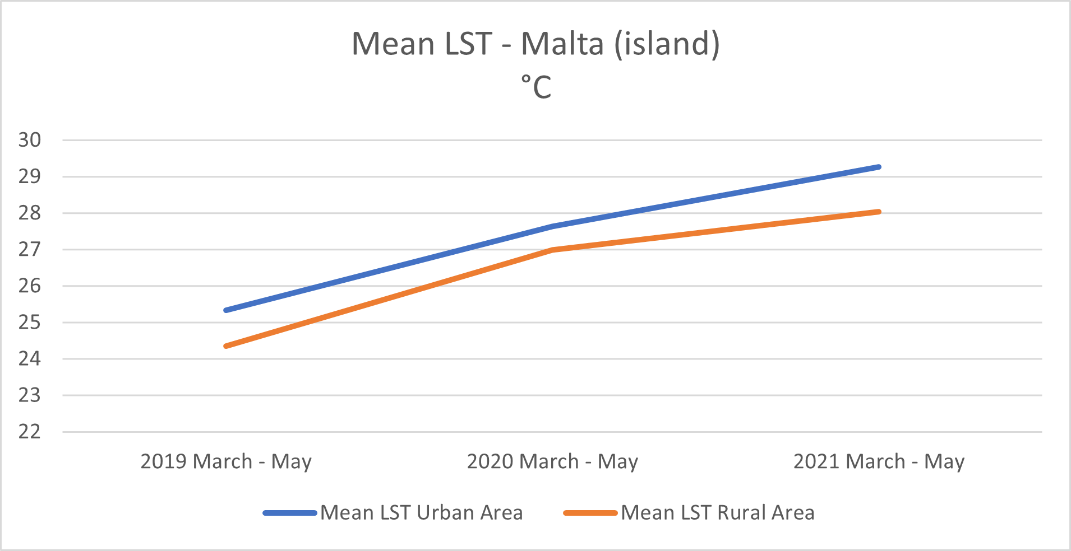
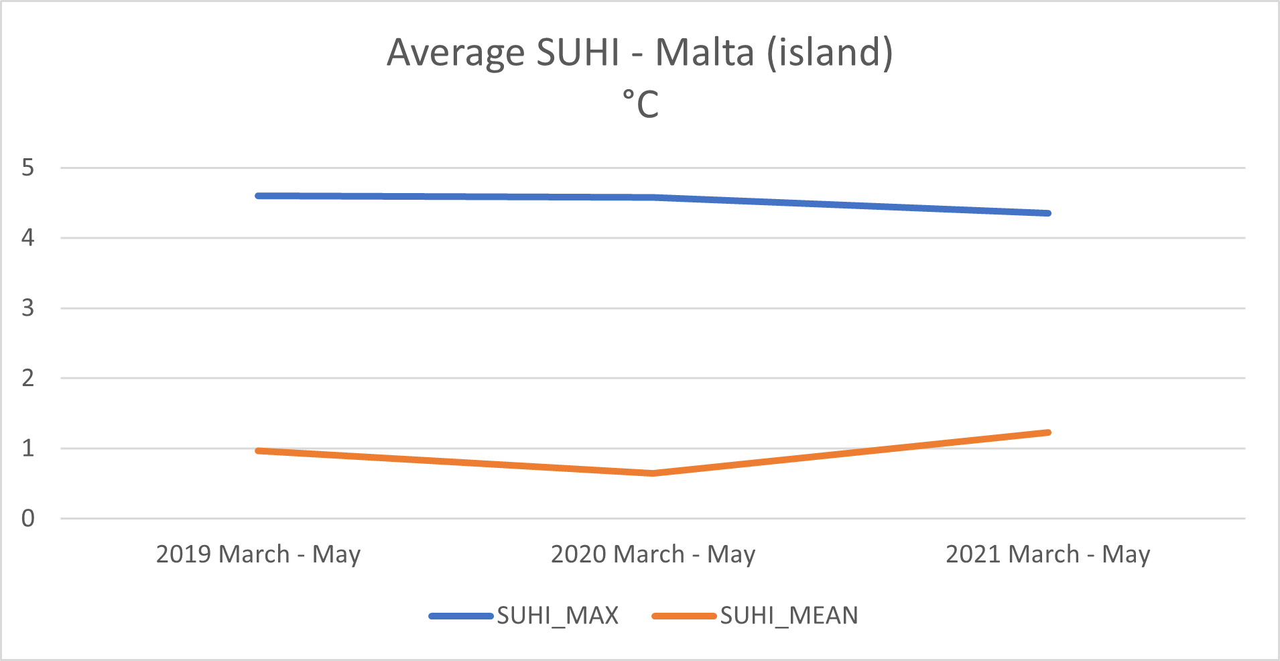
Results
“Covid” Period

Slide 26
Results
Analysis for “Summer” Period
Downward trend in LST values and a downward trend for NDVI.
Drop in Mean LST was noticed from the year 2019 to 2020.
Mean LST -1.5%.
Mean NDVI -11%
Decrease in NDVI values in the Rural areas higher than the Urban Area
-18.5% in the Rural VS -14.7% in the Urban area,
Notes:
this downtrend in NDVI could be explained by the increasing development the island is experiencing

Slide 27
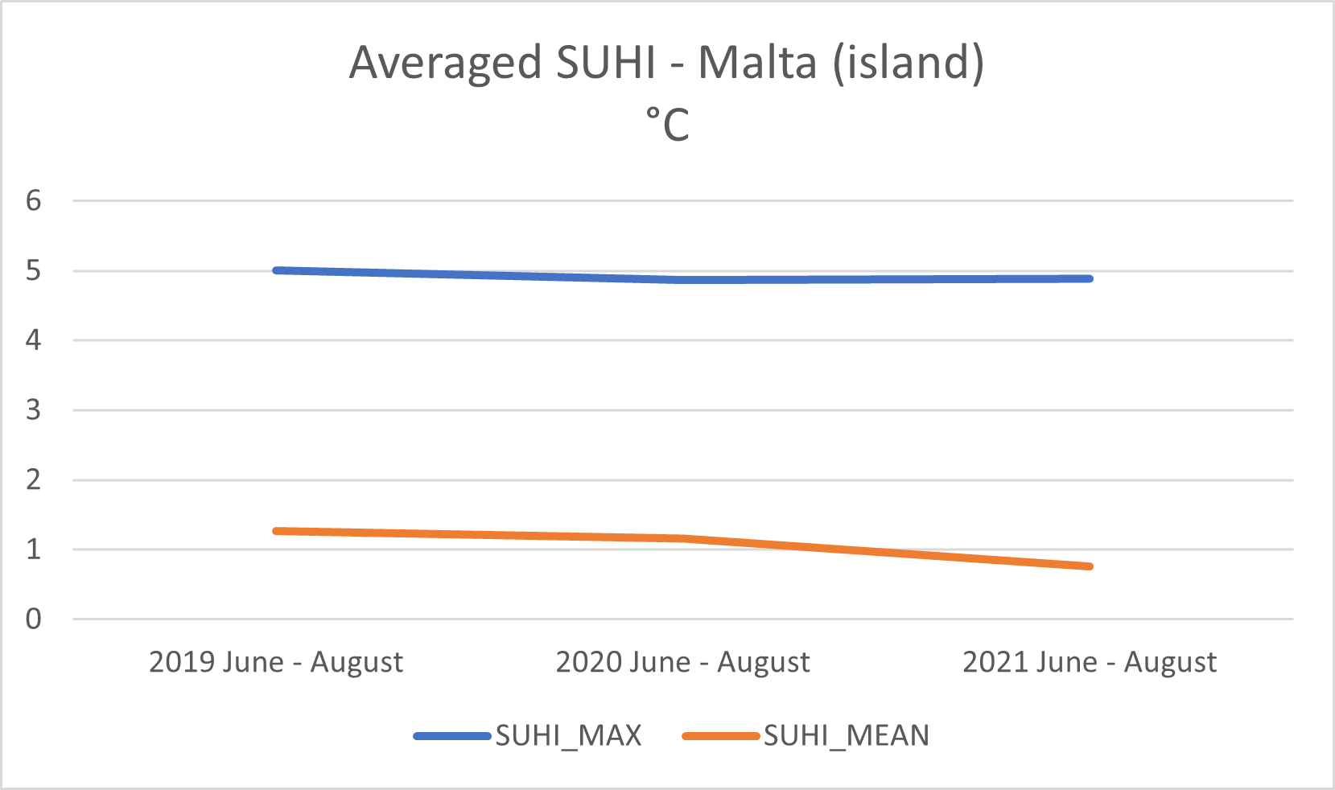
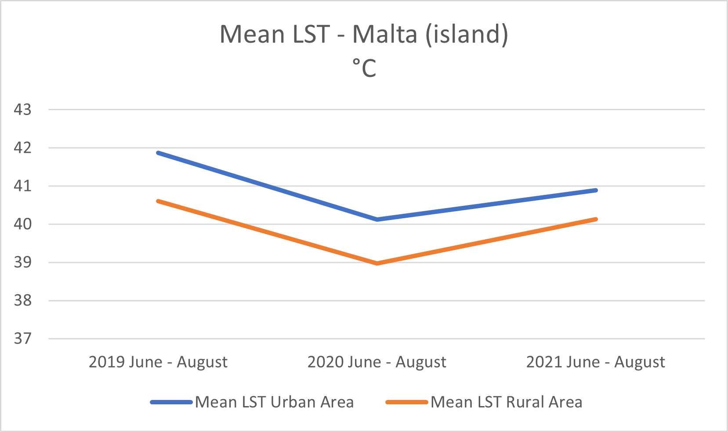
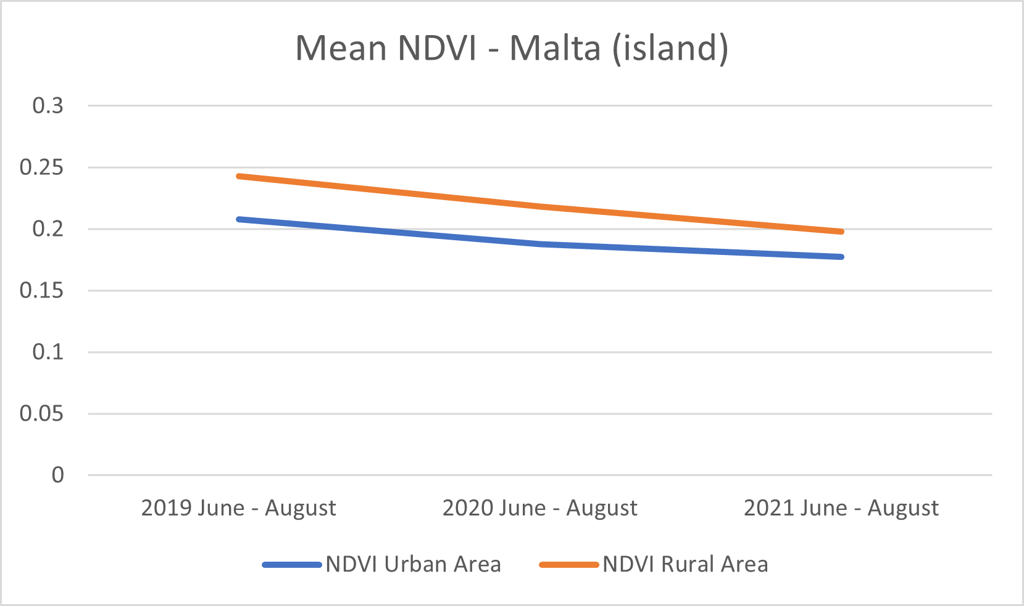
Results
“Summer” Period

Slide 28
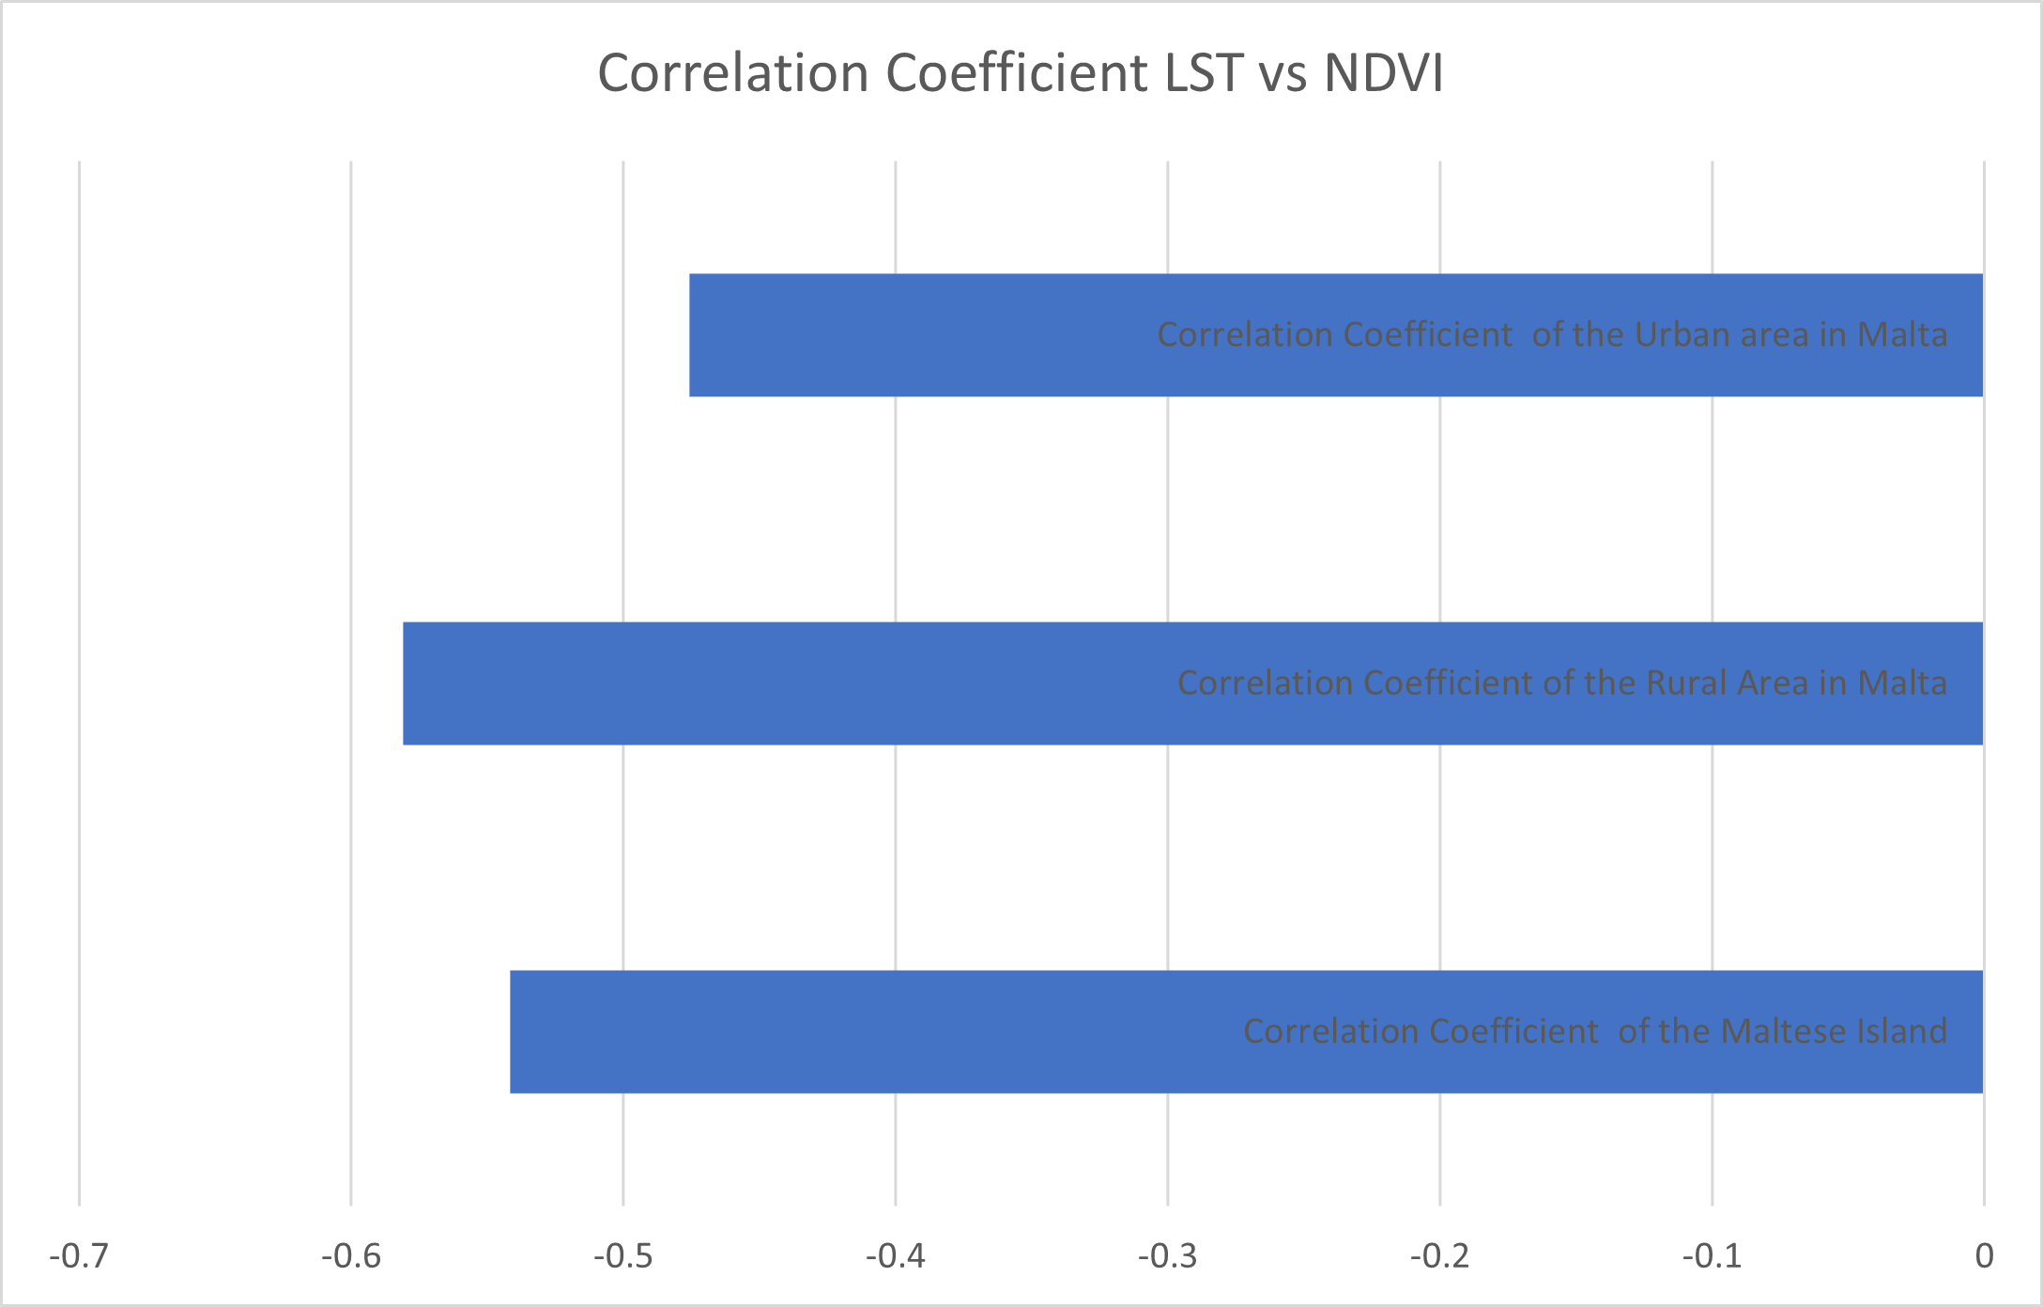
Results
Correlation Analysis
Correlation Coefficient of the main island of Malta is at -0.54
Correlation coefficient of the Rural Area was -0.58
Correlation coefficient of the Urban Area was -0.48,

Slide 29
Conclusions
Is Remote Sensing a viable option to track and observe the UHI effect in Malta?
Does the UHI effect exist in Malta?
Can UHI be tracked and analysed accurately over a period of years using Remote Sensing technologies?
Remote Sensing is a great option to track and observe the UHI effect in Malta.
UHI does affect Malta
UHI observed and analysed from 2019 – 2021.

Slide 30
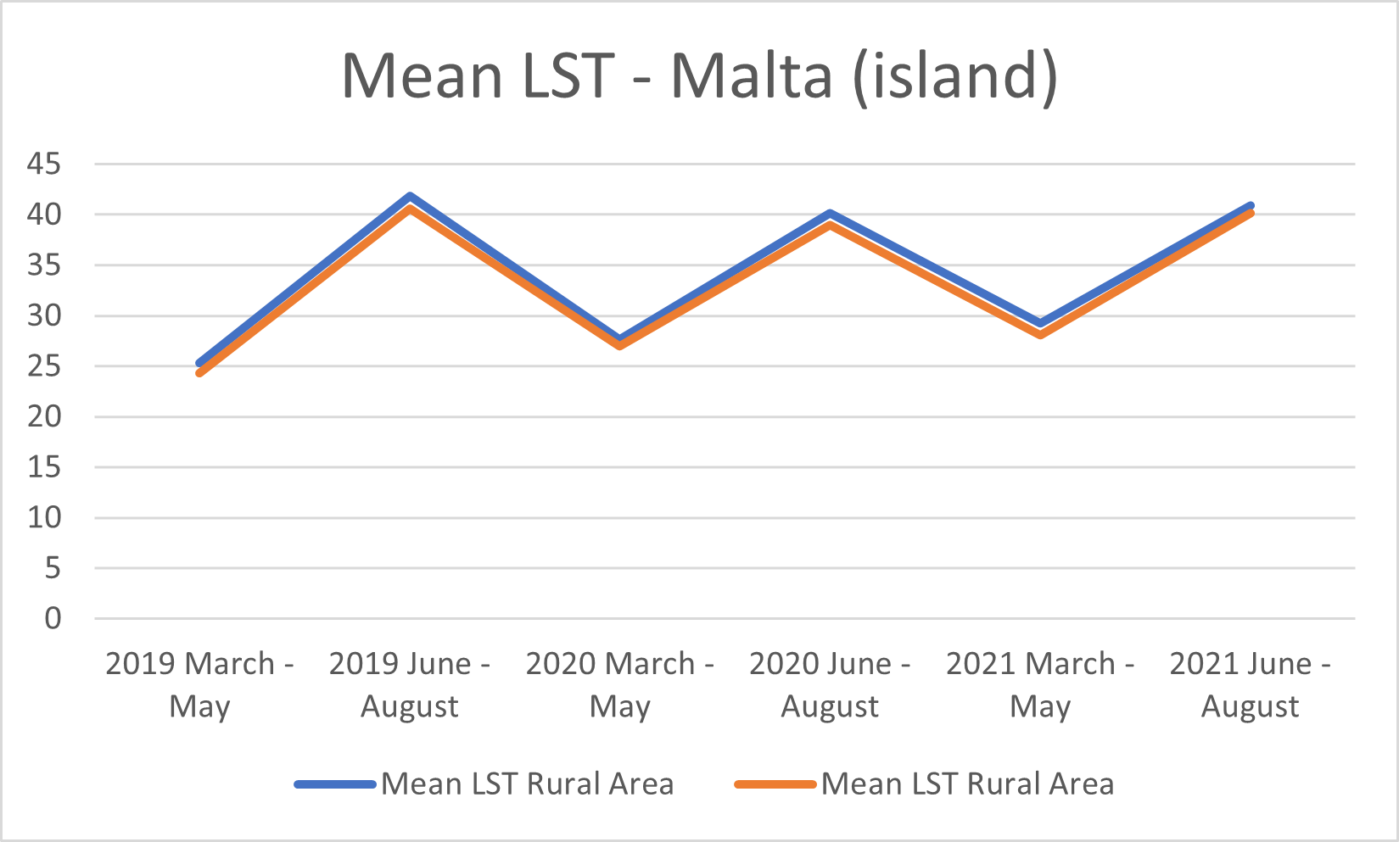
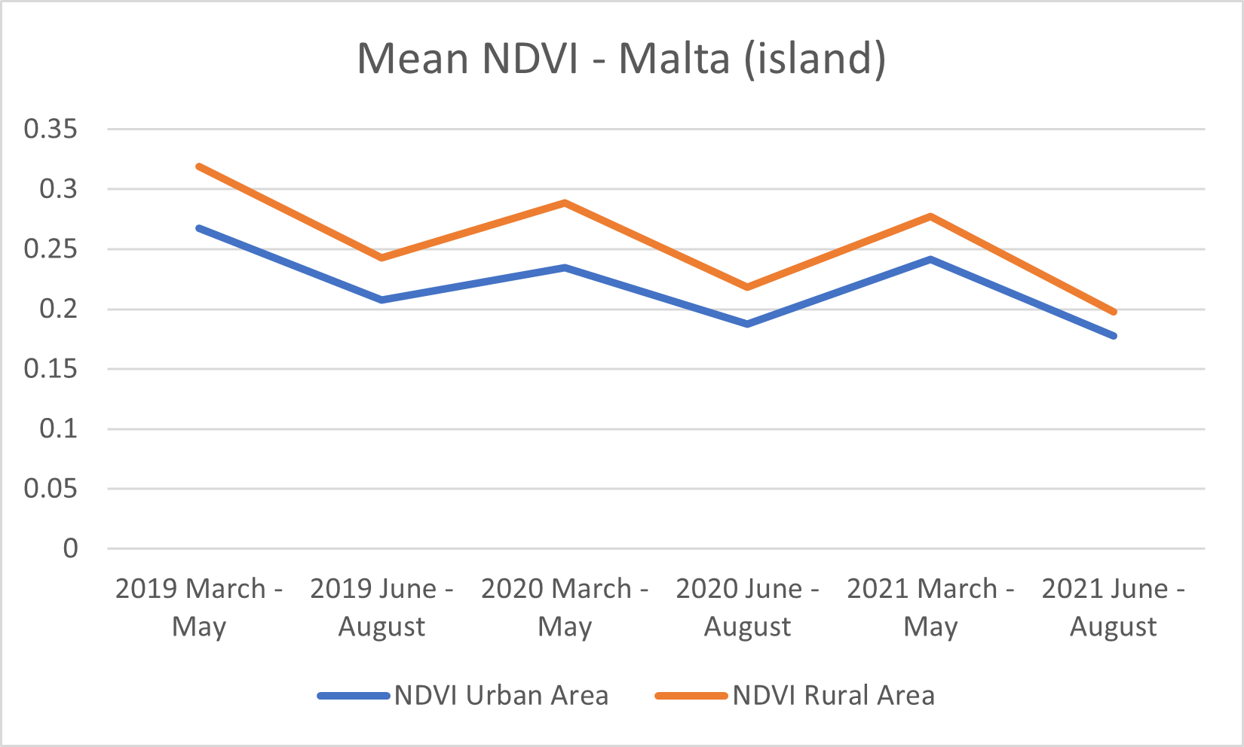
Conclusions
What kind of observations can this data provide?
Peak LST Values recorded in August.
Upward trend in Mean LST.
Downward trend in Mean NDVI.
LST vs NDVI correlation.
Uptrend slowed slightly throughout the year 2020.
LST vs NDVI correlation.

Slide 31
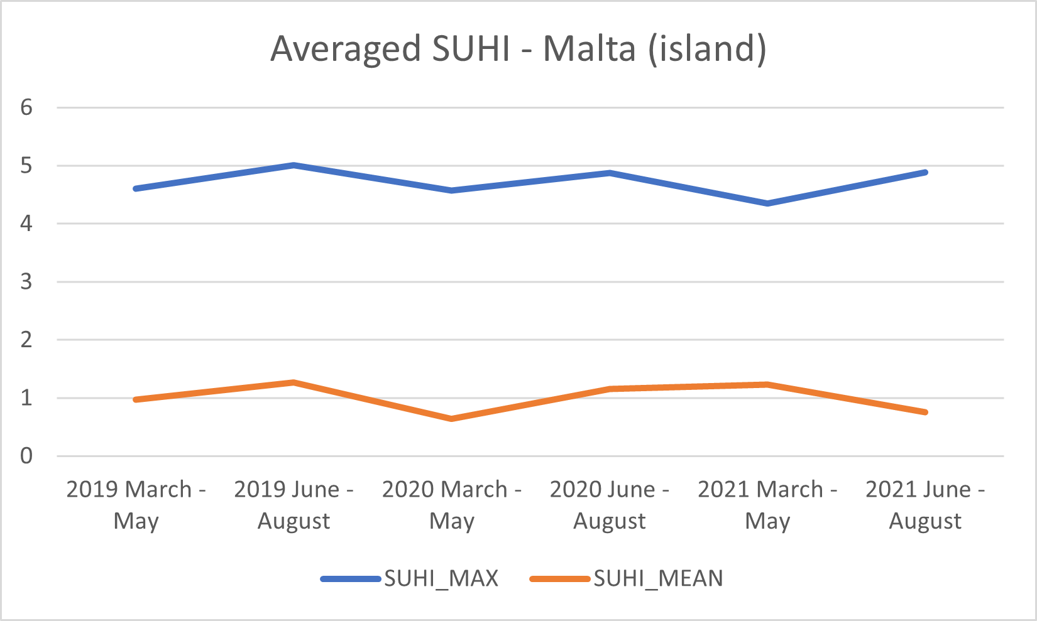
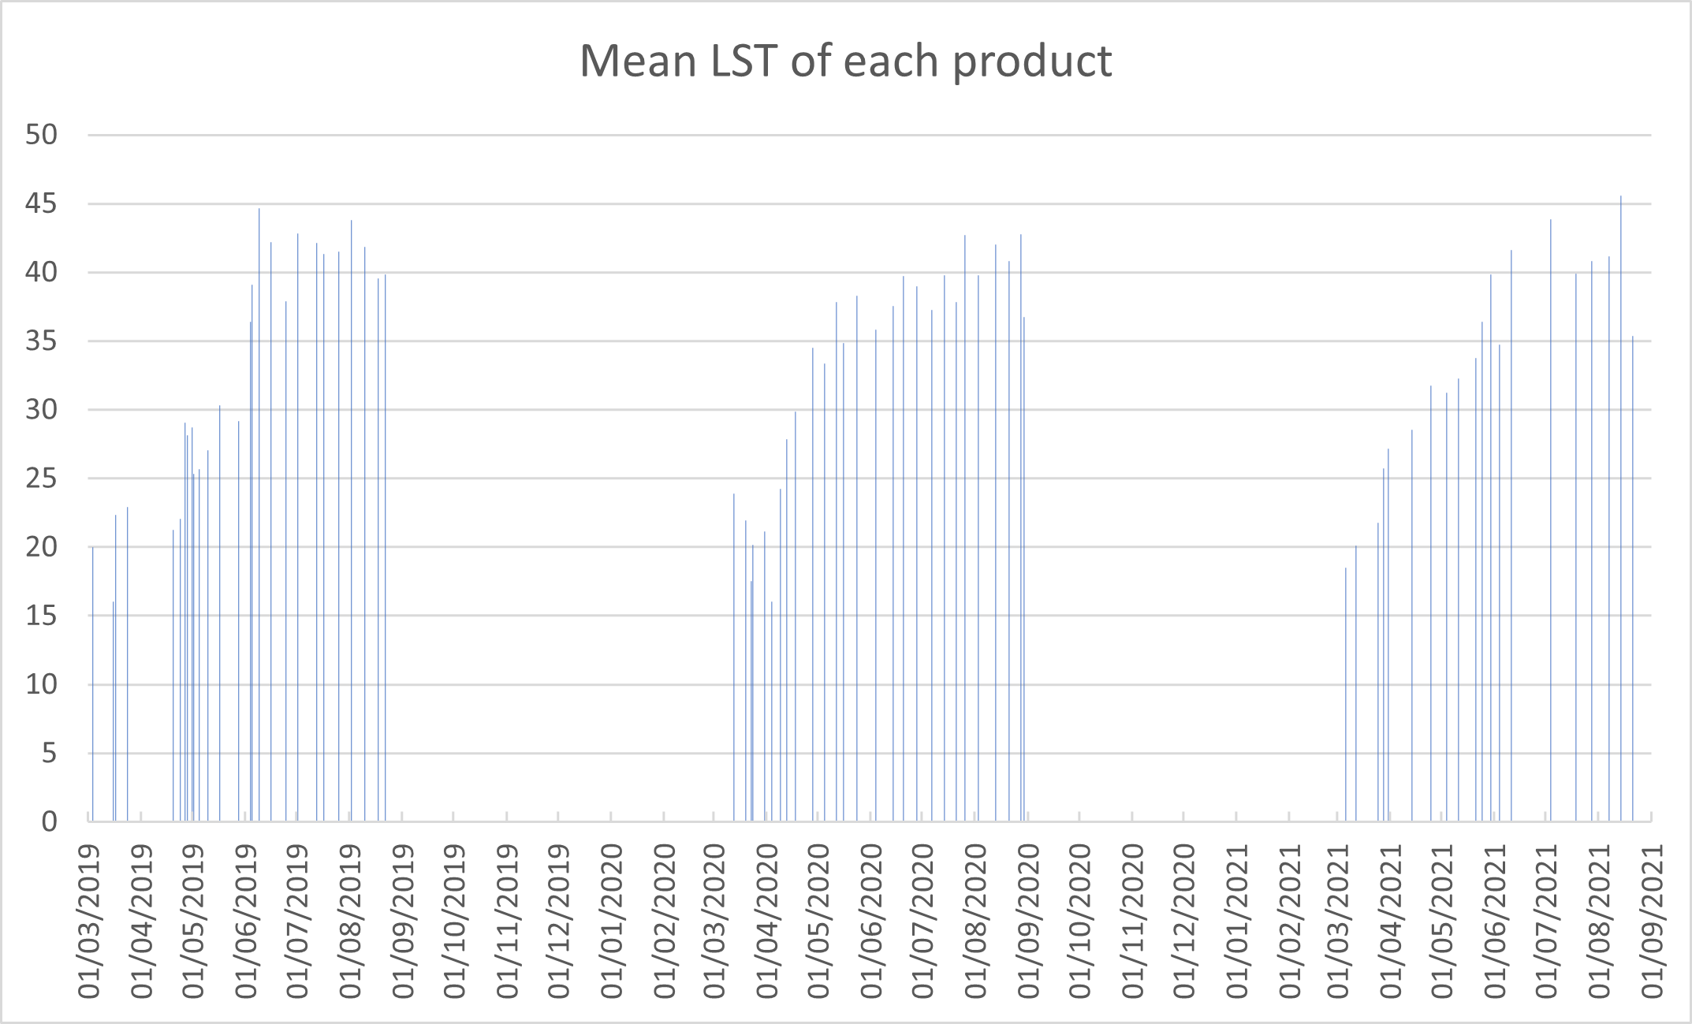
Conclusions
What kind of observations can this data provide?
SUHI_MAX downtrend due to less NDVI overall.
SUHI_MEAN uptrend due to less NDVI overall.
Spike in Mean LST around end of May / beginning of June.

Slide 32
Limitations
Cloud Cover.
Difficult to track UHI during Winter.
Limited to only 2 bands (LST and NDVI).
Issues such as satellite malfunctions and maintenance.
Processing power.

Slide 33
Future Recommendations
Multiple Remote Sensing.
More elaborate use of Land Cover Classification.
The use of local weather and data stations to track and monitor UHI during Winter.
Exploring the use of a Kubernetes system for more efficient data processing.

Slide 34
References
Arnfield, A. J. (2003), ‘Two decades of urban climate research: a review of turbulence, exchanges of energy and water, and the urban heat island.’, International journal of climatology 23, 1–26
Nakayama, T. & Fujita, T. (2010), ‘Cooling effect of water-holding pavements made of new materials on water and heat budgets in urban areas’, Landscape and Urban Planning 96(2), 57–67. URL: https://www.sciencedirect.com/science/article/pii/S0169204610000344
Karl, T. R., Diaz, H. F. & Kukla, G. (1988), ‘Urbanization: Its detection and effect in the united states climate record.’, Journal of Climate 1, 1099–1123
Landsberg, H. (1981), in ‘The Urban Climate’, Academic Press, New York, NY, USA.
Roth, M., Oke, T. R. & Emery, W. J. (1989), ‘Satellite-derived urban heat islands from three coastal cities and the utilization of such data in urban climatology’, International Journal of Remote Sensing 10, 1699–1720.
Hidalgo Garc ́ıa, D. & Arco D ́ıaz, J. (2021), ‘Modeling of the urban heat island on local climatic zones of a city using sentinel 3 images: Urban determining factors’, Urban Climate 37, 100840
Sobrino, J. A. & Irakulis, I. (2020), ‘A methodology for comparing the surface urban heat island in selected urban agglomerations around the world from sentinel-3 slstr data’, Remote Sensing 12(12), 2052

Slide 35
Thank you Massimo Darmanin

